Slide 2
Introduction
Name
Cresyn Co., Ltd.
Established
March, 1959
Capital
US$ 3.1M
Sales Revenue
2009: US$ 240M, 2010: US$ 258M, 2011: US$ 280M,
2012 : US$314M , 2013 : US$ 370M (Expectation)
Capacity
Finished Products : 26,000,000 pcs per month Receiver Unit : 40,000,000 pcs per month
Employees
Korea : 210 employees Overseas : 11,800 employees (2012)
Main Business
Own Brand Business_CRESYN / PHIATON ODM & OEM Business EMS (Electronic Manufacturing Service)
Main Products
Earphones, Headphones, Headset, Bluetooth ISM(Image Sensor Module), Receiver Unit, Micro Speaker, Wire, Charger

Slide 3
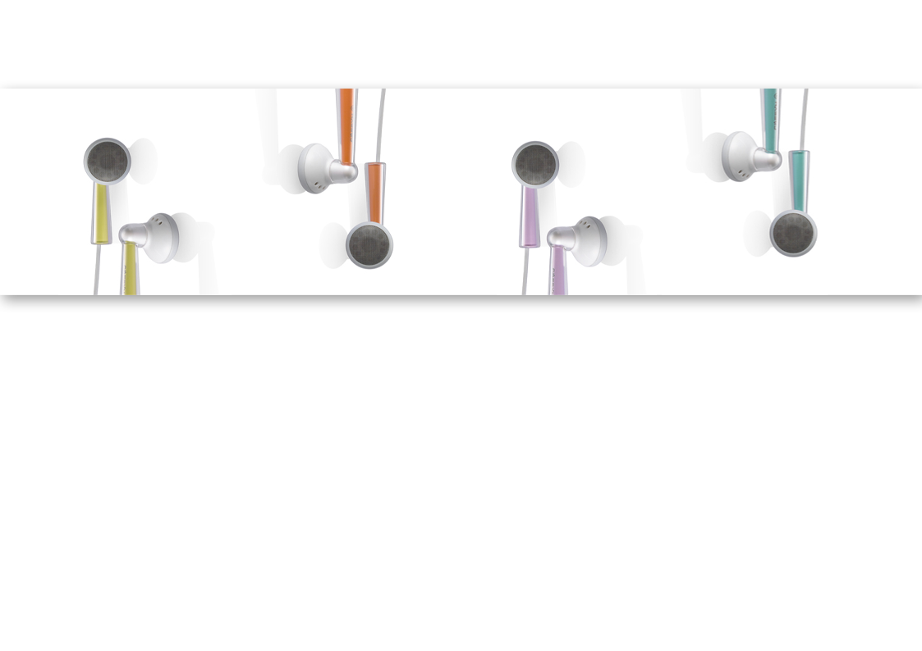
Cresyn CI
Create + Syn [新: The New] = Cresyn (New Creation)
The Cresyn philosophy focuses on innovation, quality and competitiveness through customer value creation. Cresyn encourages the spirit of self-development for its employees and enhances environmental and social responsibility across its global manufacturing operations.

Slide 4
History
Initial Phases
Growth Phases
Taking-off Phases
1959. 03 Founded Daehan Phonograph Needle factory
1981. 05 Started Manufacturing Stereo Headphones
1985. 06 Corporated Shinwoo Audio Co., Ltd. (President: Jong-Bae Lee)
1990. 11 Established Shinwoo Japan
1991. 08 Established PT. Shinwoo Indonesia
1992. 05 Completed Jechon factory in Korea
1998. 12 Acquired KS A/ISO 9001
2000. 01 Established Dongguan factory in China
2002. 01 Company reborn with name of Cresyn Co., Ltd.
2002. 10 Acquired TL9000
2002. 12 Inauguration of President, Jin Na
2003. 03 Acquired ISO14001
2003. 10 Established Tianjin factory in China
2003. 10 Begun ISM / Lens business
2005. 12 Established acoustic R&BD lab.
2005. 12 Established Heyuan factory in China
2006. 1 Won the Korea world-class Product Award 2005
2007. 7 Established PHIATON Corp. in USA
2009. 3 Won International Design Award 2009 in USA

Slide 5
Philosophy
Own responsibility For the humankind
Social responsibility through
Environmental company management
Create value For customers
Develop best quality and innovative products making
competitive power through high customer value realization
Frontier spirit For self development
자기 발전에 도전의식
Attract and retain talented people maximize
potential capabilities through people development

Slide 6
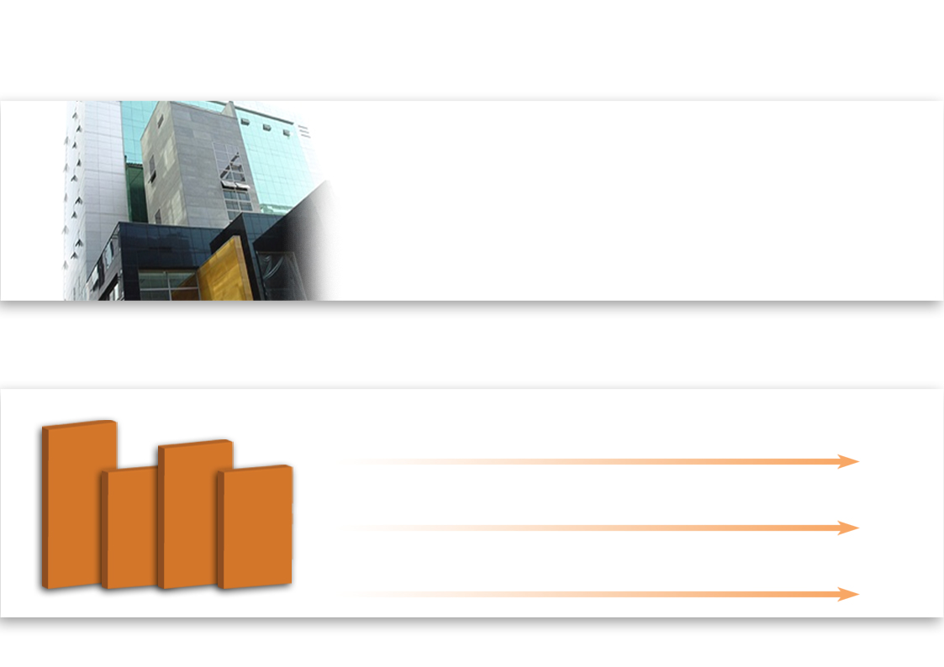
Sales Status
No.1 earphone & headphone manufacturer in domestic market
Launch ISM (Image Sensor Module) into before-market
Won the Korea World-Class Product Award 2005 ~ 2008
Launch Bluetooth, Premium audio equipment, PHIATON brand line-up into global market
Sales Growth
U$ 330M
U$ 270M
Headset for
Mobile phone
Market Share (Korea) 70%
Market Share (Overseas) 15%
U$ 240M
U$ 258M
U$ 240M
Earphones,
Headphones
Market Share (Global) 30%
Own Brand Business
Sales Growth Rate (every year) 110%
2006
2007
2008
2009
2010

Slide 7
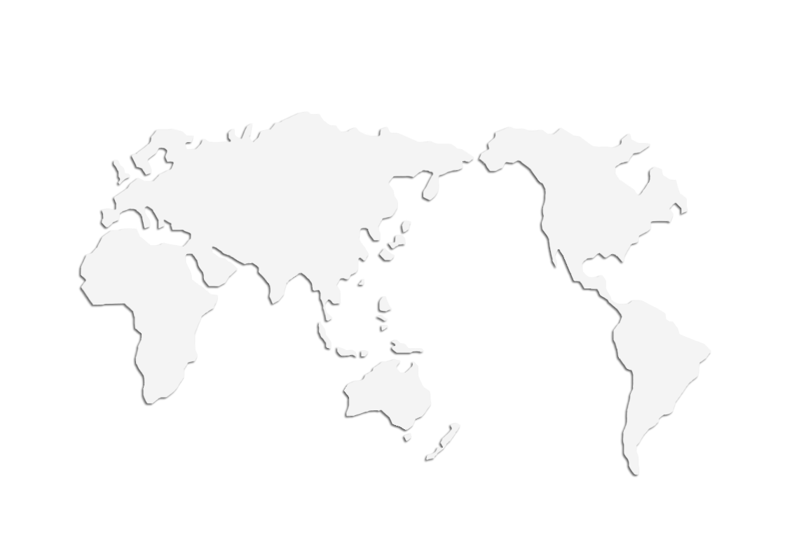
Global Network
TIANJIN
Employees : 2,500
Capacity : Finished product – 5M pcs per month
ISM - 3.5M pcs per month
Product : Earphone, Remote, Headphone, Headset, ISM, etc.
YOKOHAMA
CALIFORNIA
- Sales for Japan customers
- Management of import and export
- Sales for USA market
- Marketing activity
- Management of import and export
HEYUAN
Employees : 2,500
Capacity : 6M pcs per month
Product : Earphone, Headphone, Headset, Bluetooth, Charger, etc.
Phiaton Corp
Cresyn Tianjin
HQ.(Seoul)
Cresyn Heyuan
Cresyn Japan
Leevin Dongguan
Cresyn Dongguan
DONGGUAN
LEEVIN
Employees : 2,500
Capacity : 6M pcs per month
Products : Earphones, Remote, Headphone, Headset
Employees : 500
Capacity : 15M m per month
Product : Cord Wire
Cresyn Indonesia
Longvin Indonesia
LONGVIN
INDONESIA
Employees : 500
Capacity : 30M pcs per month
Products : Receiver Unit
Employees : 2,100
Capacity : Finished product – 5.5M pcs per month Receiver Unit - 10M pcs per month
Product : Earphone, Headphone, Headset, Receiver Unit, etc

Slide 8
Global Customer
Europe
America
Sweden
Korea
Swiss
Russia
Canada
Germany
China
Italy
USA
Korea
Japan
Japan
South Asia
Chile
Cresyn Brand
OEM, ODM

Slide 9
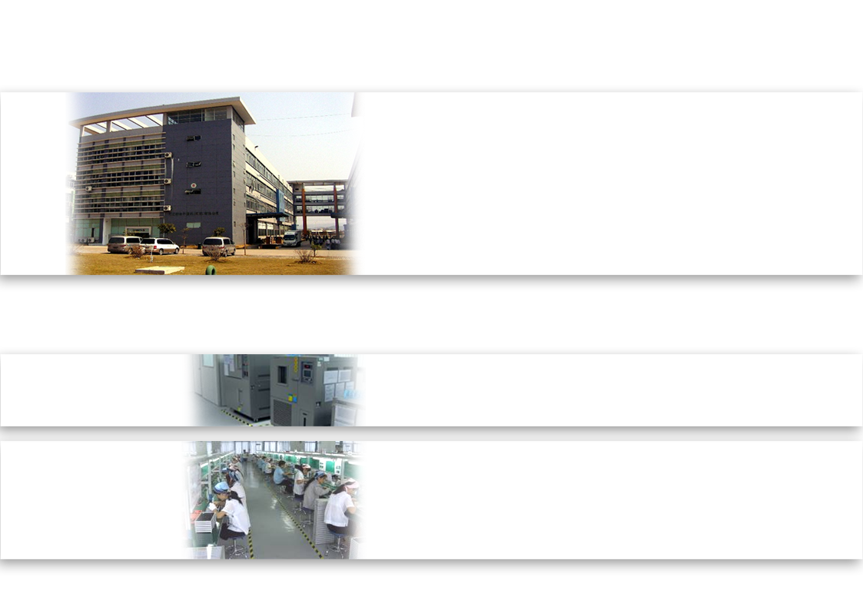
Heyuan Factory, China
Name
Cresyn Electronics (He Yuan) Co., Ltd.
Established
Dec. 2005
Address
Hi-Tech Development Zone, Technology Rd. No.4, Industry Area, Building NO.4, Heyuan, China
Employees
Total : 1,300 ( 2010 )
Certification
TL9000, ISO 9001:2000, ISO 14001:2004
CAPACITY
Product : Headset, Earphones, Bluetooth, Headphones, Charger, etc.
CAPA : 6,000,000 pcs per month (finished product)
*Mass production of OEM audio accessory.
*Main Customer : APPLE, SAMSUNG, RIM, MOTOROLA, etc.
*New factory will be built in He Yuan.
_Development for main manufacturing facility in Guang Dong area.
_Cord / Injection / Production line will be equipped.
FEATURE

Slide 10
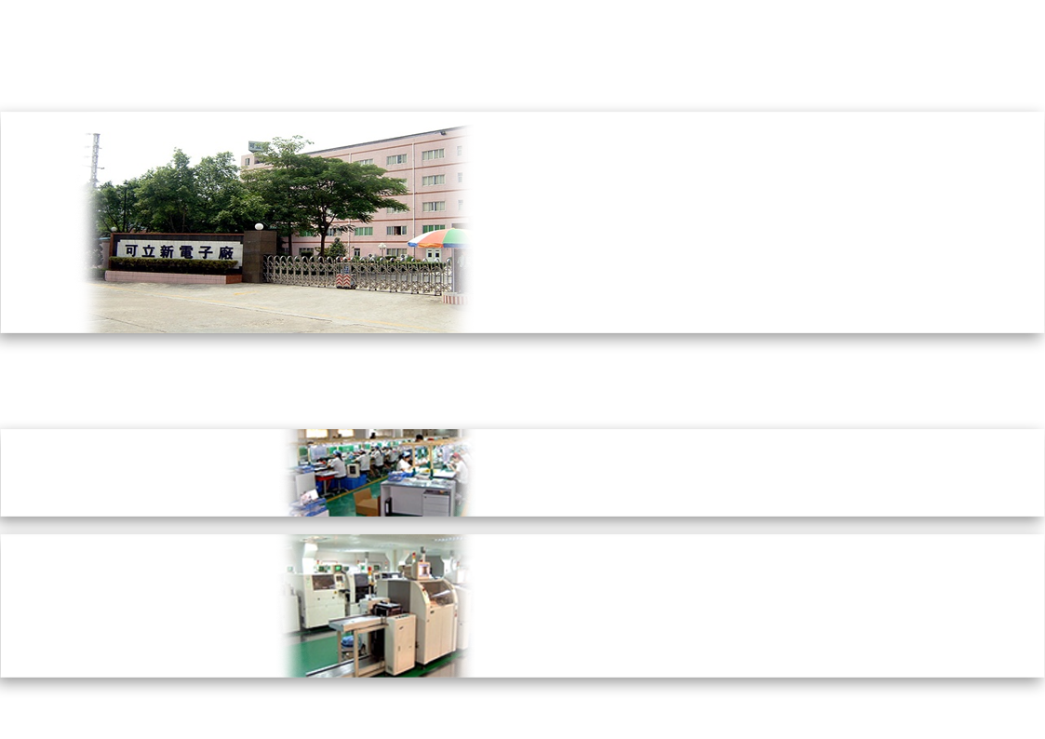
Dongguan Factory, China
Name
Cresyn (H.K) Co., Ltd.
Established
Jan. 2000
Address
Factory : Lin-Chun Industry Zone, Tang Xia, Dongguan, GuangDong, China
Employees
H.K Office : 33 Canton Road Tsimshatsui, Hong Kong
Certification
Total : 1,000 (2010 )
TL9000, ISO 9001:2000, ISO 14001:2004
Product : Headset, Earphones, Headphones, etc.
CAPA : 4,000,000 pcs per month (finished product)
CAPACITY
FEATURE
*Manufacturing CRESYN and PHIATON brand line-up.
*Operating overseas R&D / Accounting / Development Purchase Depts._Managing overall China facilities for effective localization

Slide 11
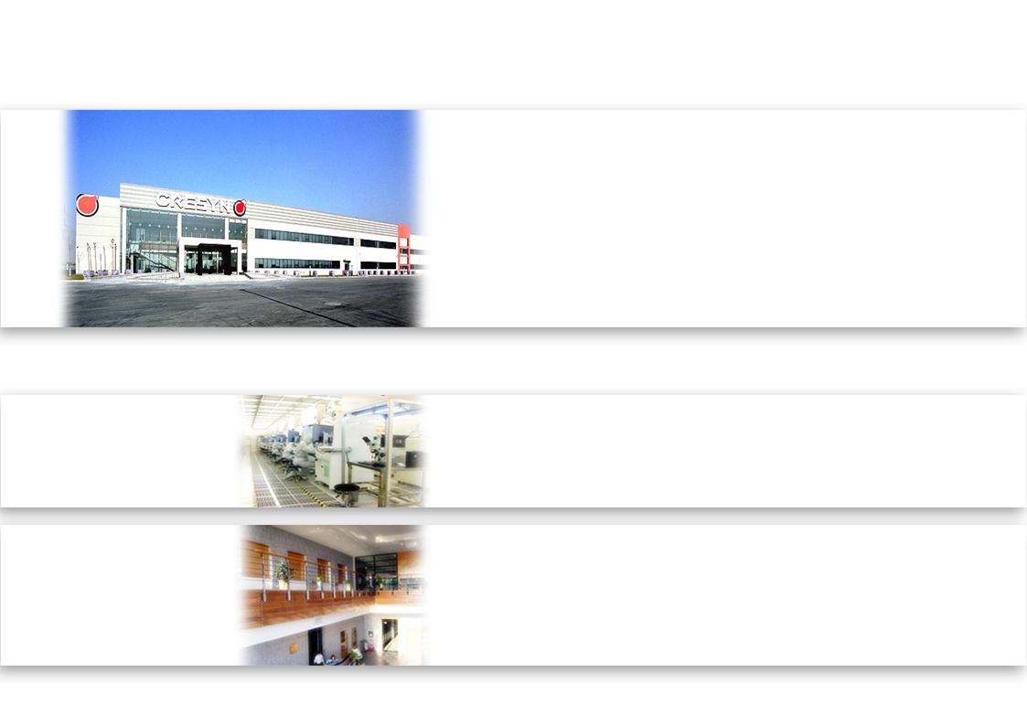
Tianjin Factory, China
Name
Cresyn (Tianjin) Co., Ltd.
Established
Oct. 2003
Address
Micro Electronics industrial Park, Tianjin Economic Technologic Development Area, Tianjin, China
Employees
Total : 2,500 ( 2010 )
Certification
TL9000, ISO 9001:2000, ISO 14001:2004
Product : Headset, Earphones, ISM, etc.
CAPA
_Earphones, Headset : 7,000,000 pcs per month (Finished product)
_ISM : 3,500,000 pcs per month (Finished product)
CAPACITY
*Manufacturing Headset, Earphones of mobile phone for OEM business.
*Aggressive investment for increasing productive capacity and maximizing R&D._Have a plan to establish Tianjin Optical research lab.
*Main customer : SAMSUNG, BIRD SAGEM, PANTEC, etc.
FEATURE

Slide 12
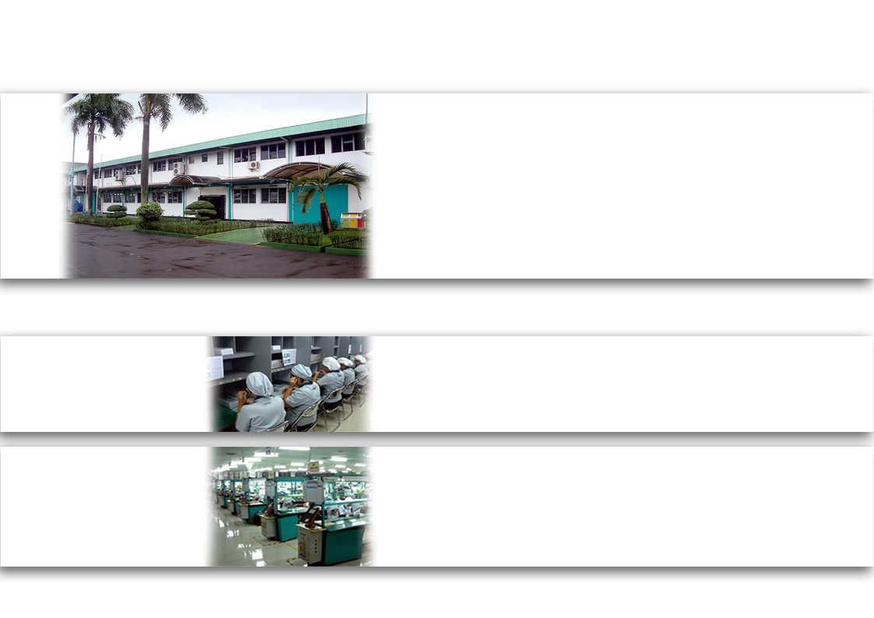
Indonesia Factory
Name
PT. CRESYN INDONESIA
Established
Aug. 1991
Address
KP. Rawahingkik, DS. Limusnunggal Cileungsi, Bogor, West Java, Indonesia
Employees
Total : 3,000 ( 2010 )
Certification
TL9000, ISO 9001:2000, ISO 14001:2004
Product : Headset, Earphones, Headphones, Receiver Unit, etc.
CAPA
_Headset, Earphones, Headphones : 5,500,000 pcs per month (Finished product)
_Receiver Unit : 10,000,000 pcs per month
CAPACITY
*Manufacturing Receiver Unit for finished product of Cresyn’s own brand and OEM/ODM models.
*Main manufacturing facility in Indonesia that can handle with production from main parts to finished product.
*Main Customer : Sony, Audio Technica, LG, Maxell, etc.
FEATURE

Slide 13
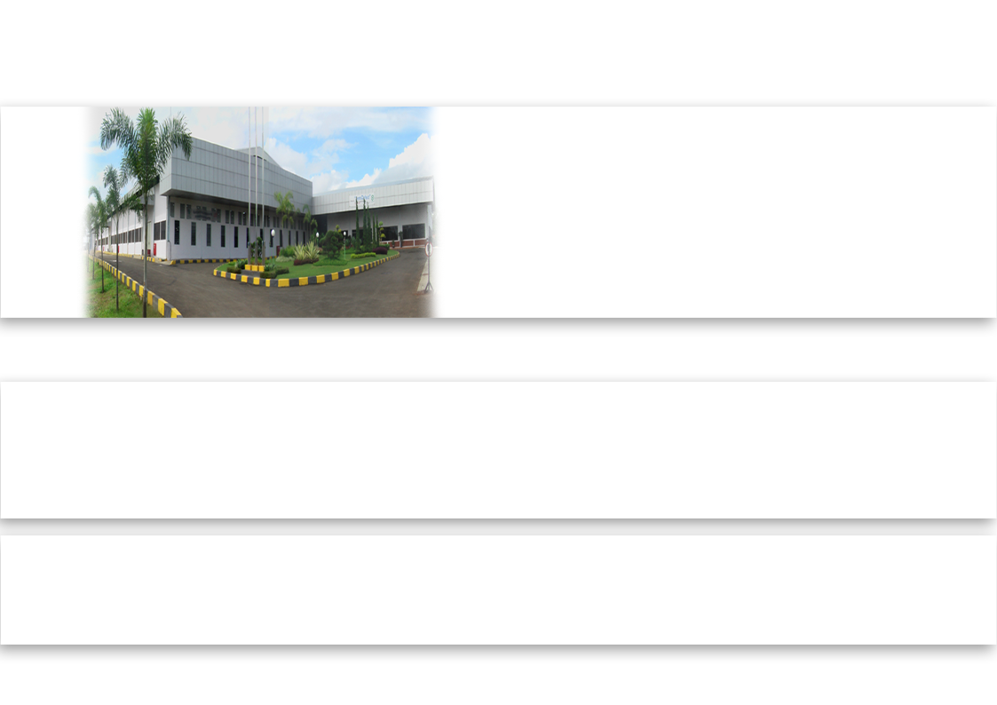
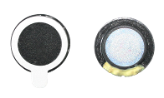
Long Vin, Indonesia
Name
PT. Long Vin Indonesia
Established
Dec. 2005
Address
Bojongkokosan, Parungkuda Kab. Sukabumi, West Java, Indonesia
Employees
Total : 7,000 ( 2010 )
Certification
ISO 9001:2000
*Main Product : Receiver Unit , Micro Speaker, Loudness Speaker, etc.
*CAPA : 30,000,000 pcs per month
*Specialized in production of Receiver Unit, Speaker part.
Have connection with acoustic R&D lab for effective development of Speaker.
*Production and supply to all Cresyn manufacturing facilities.
Capacity & Feature
Main Product

Slide 14
Lee Vin, China
Name
Leevin Electronics Telecommunication (Dongguan) Co., Ltd.
Established
Jun. 2004
Address
Dongguan, Guang Dong, China
Employees
Total : 500 ( 2010 )
Certification
TL9000, ISO 9001:2000, ISO 14001:2004
*Main Product : Cord Wire
*CAPA : 15,000,000 M per month
*Manufacturing and supplying Cord set, Wire for Earphones, Headphones, Headset, etc.
Capacity & Feature
Main Product

Slide 15
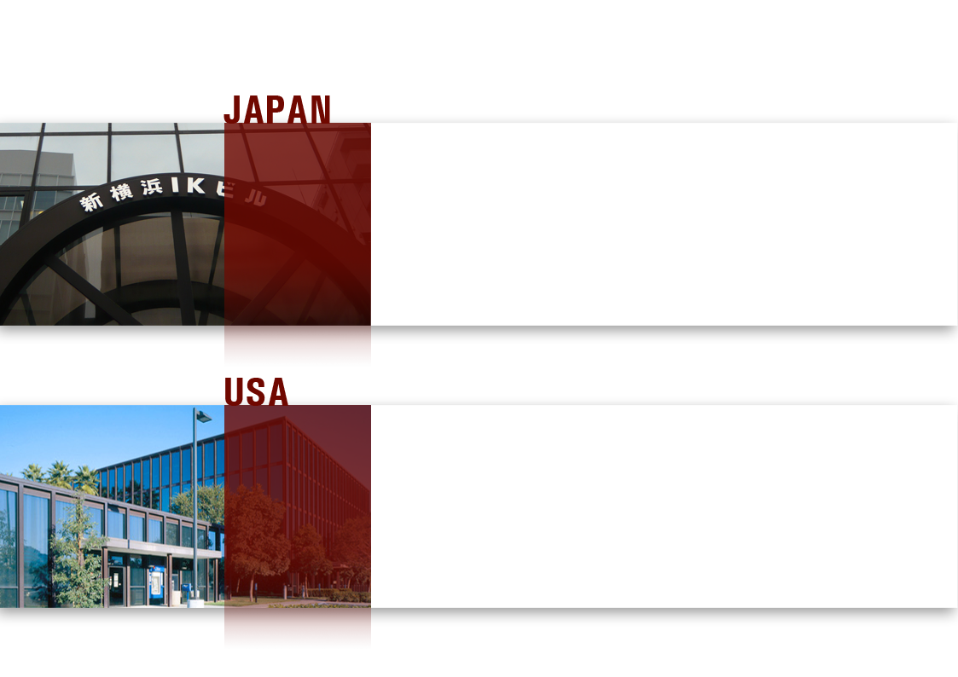
Sales Office, Japan / USA
Name
Cresyn Japan
Address
Shinyokohama Kouhoku-ku Yokohama City, Kanagawa-Ken, Japan
Established
Nov. 1990
Main Duty
*Sales activity for Japan customers
*Quality Management
*Main customers : AIWA, Audio Technica, JVC, SONY , TOSHIBA, Denon, etc
Name
PHIATON CORPORATION
Address
18662 MacArthur Blvd #405 Irvine, California, 92612
Established
Jul. 2007
Main Duty
*Marketing & promotion activity for PHIATON brand
*Searching for new competent customer of USA and EU.
*Supports Cresyn’s own brand sales of USA and EU market.

Slide 16
Why Cresyn?
Futuristic Design Product
Tradition of High Quality
*Operate CRESYN design team
*Won several design awards from overseas
*Acquired the quality certification of TL9000 /ISO 9001:2000 / ISO 14001:2004
*Strong quality control by technically qualified Personnel
*Verified superiority compared to other competitor’s quality and high level of satisfaction from many OEM/ODM partners for 20 years
Competitive Price
*Well established and organized factory
(5 manufacturing facilities in China, Indonesia)
*Capability to produce 23Million headphones per month
*Optimized manufacturing process for mass production
*Lower manufacturing cost than other competitors
Strong R&D
*Excellent R&D to develop the value added products
*Highly qualified engineers with experience
*Have complete headphones technology from making main parts to finished products
*Operate acoustic R&D Lab.

Slide 17
NEW PRODUCT

Slide 18
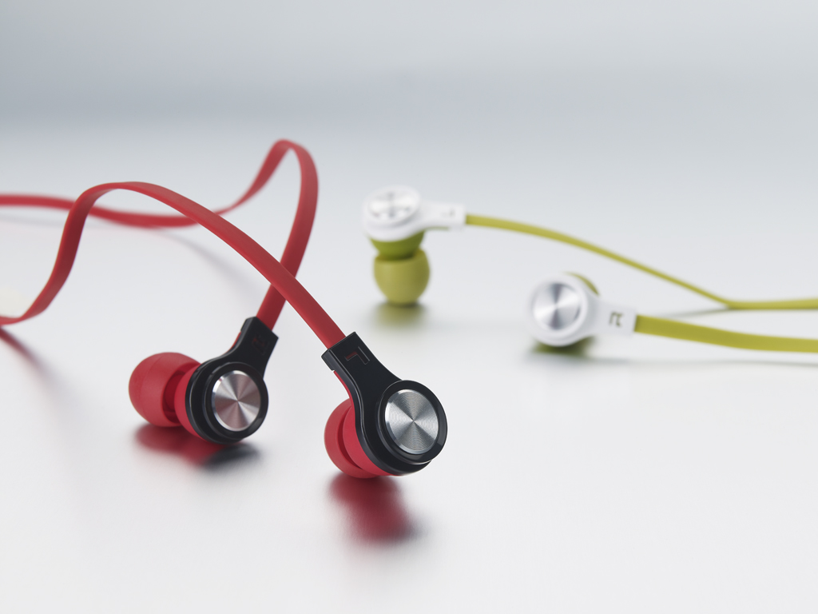
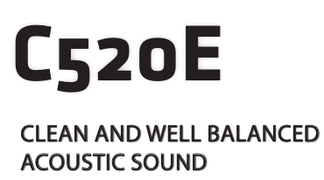
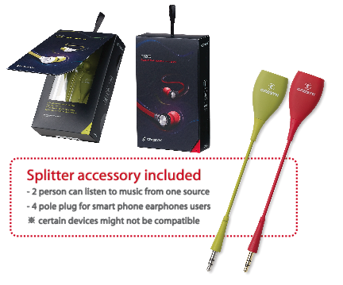

Slide 19
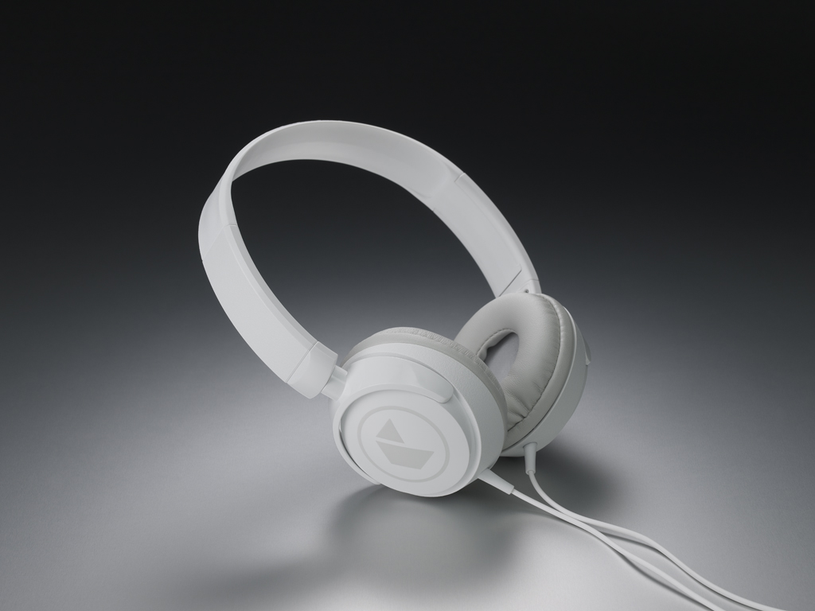
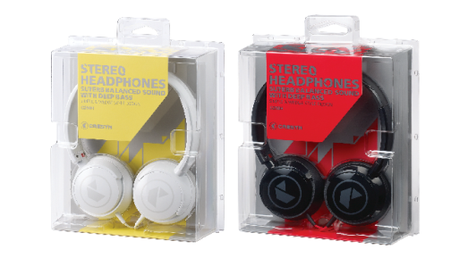

Slide 20
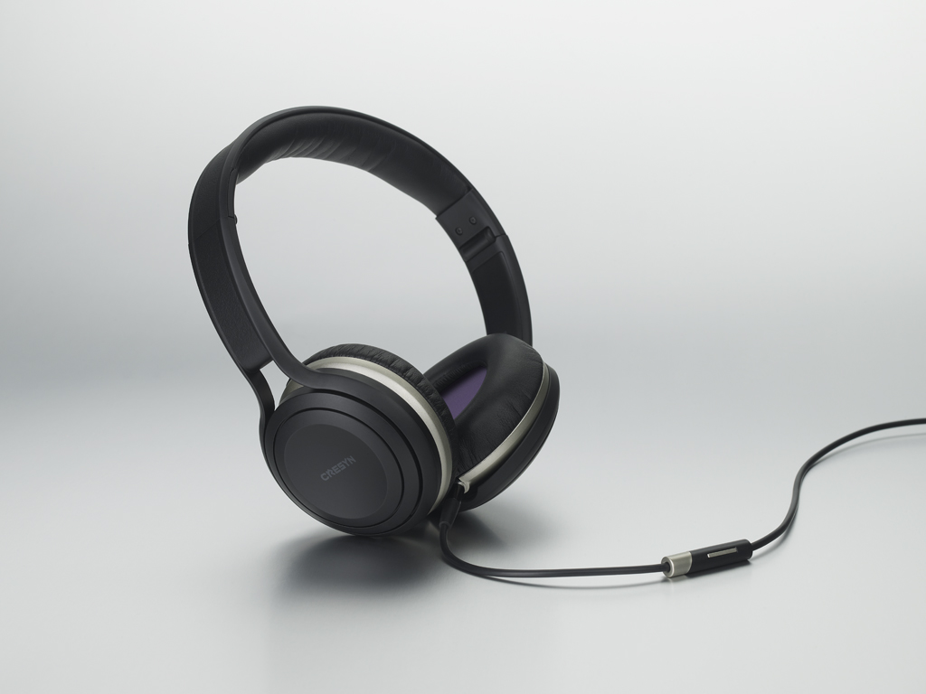
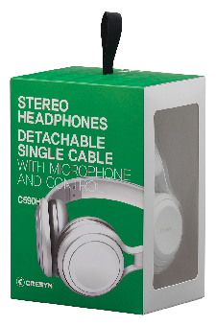
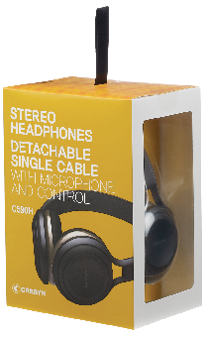

Slide 21
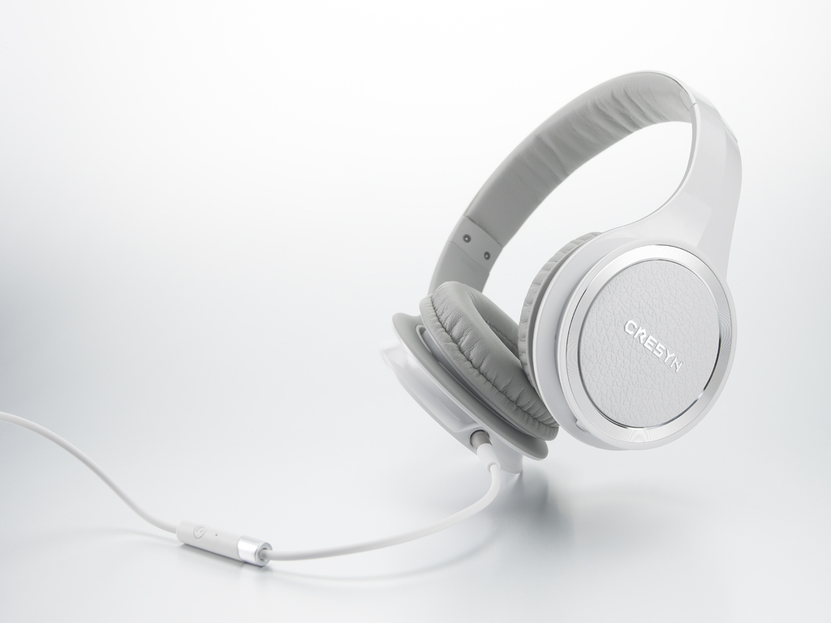
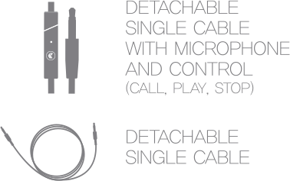
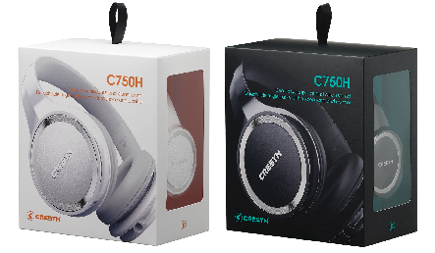

Slide 22
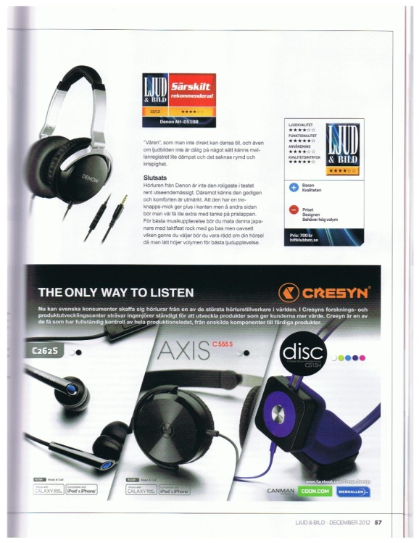
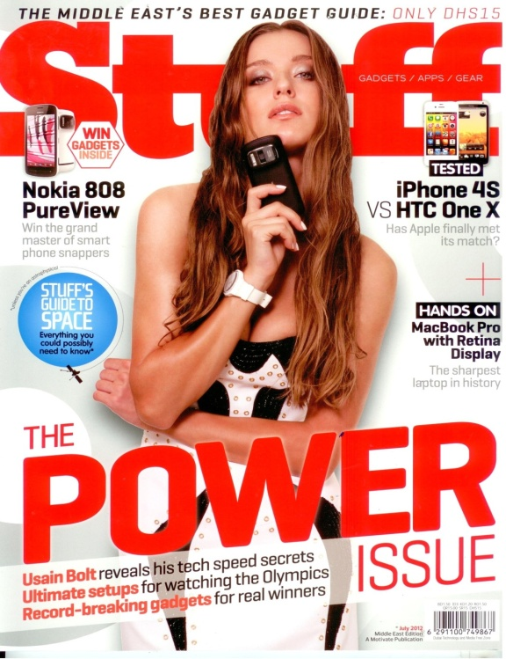
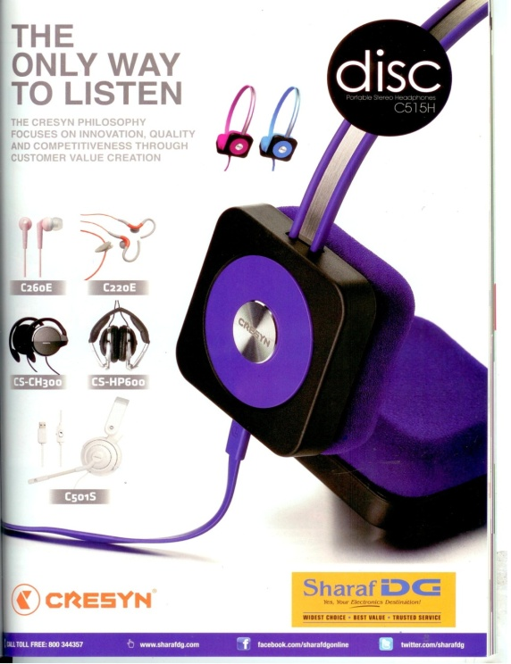
Cresyn PR from Sweden (DEC.2012)
Cresyn PR from UAE (2012. July.)
Cresyn PR from Singapore (2012. May.)
“T3” magazine : AXIS (C555S)
CRESYN PR_ Czech Republic
HD World Magazine : May. 2012

Slide 23
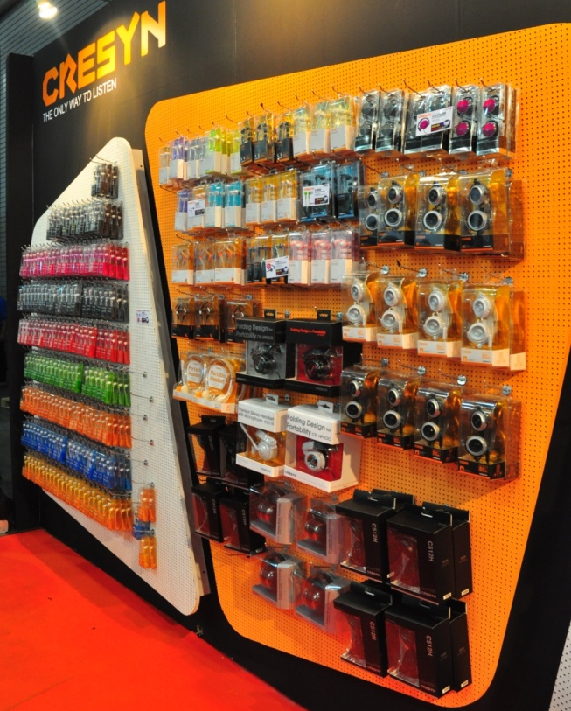
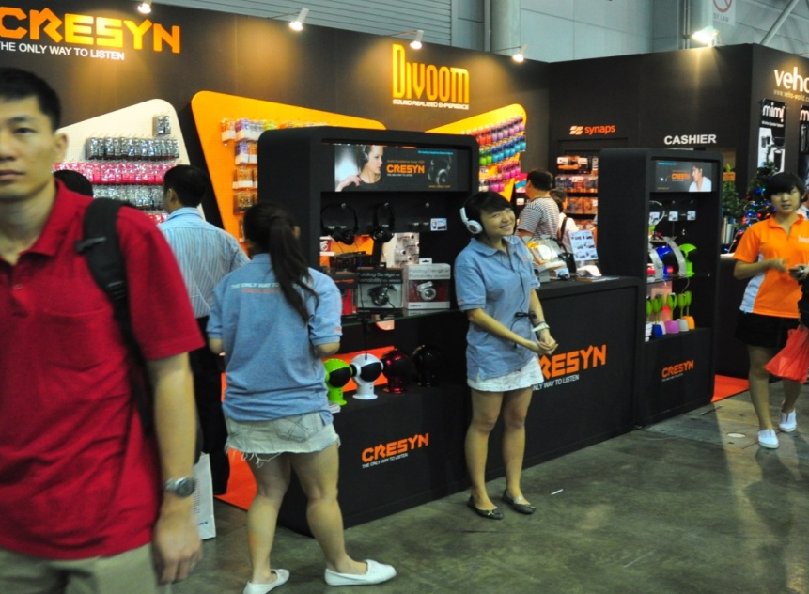
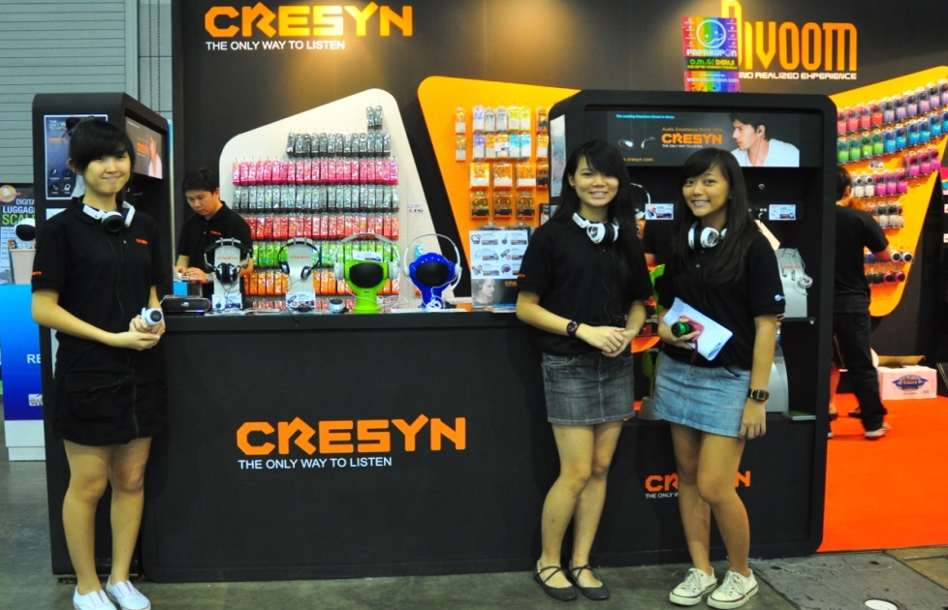
SITEX 2010
IT Show 2011

Slide 24
Gadget Show 2012

Slide 25
Magazine

Slide 26
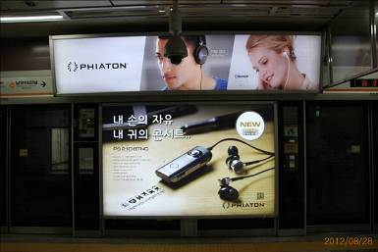
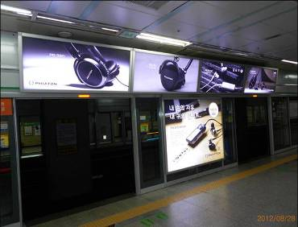
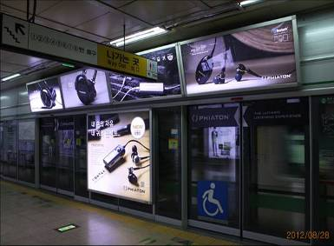
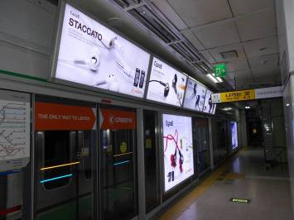
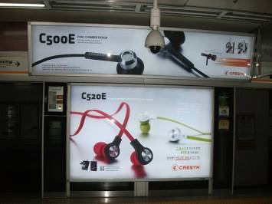
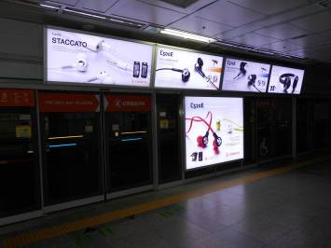
스크린 도어
광고

Slide 27
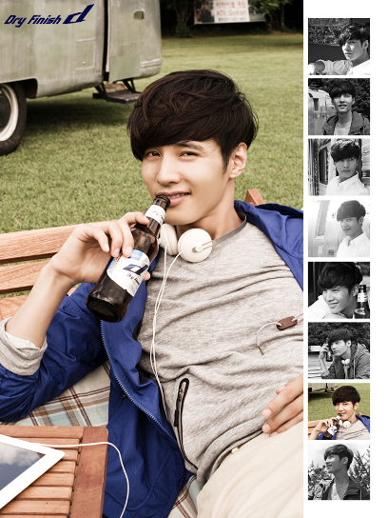
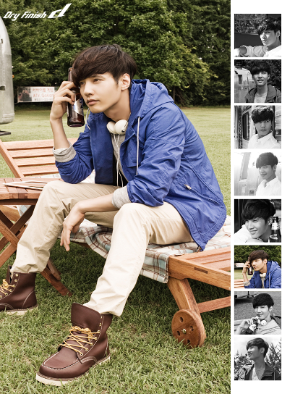
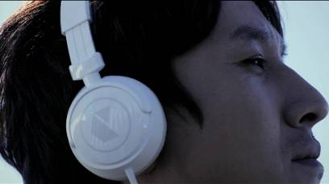
Entertainment

